Slide 2

İGA DATA DRIVEN AIRPORT
Flight Resources & Systems Tracking
Bigdata & Analytics Department
13 Oct 2025

Slide 3
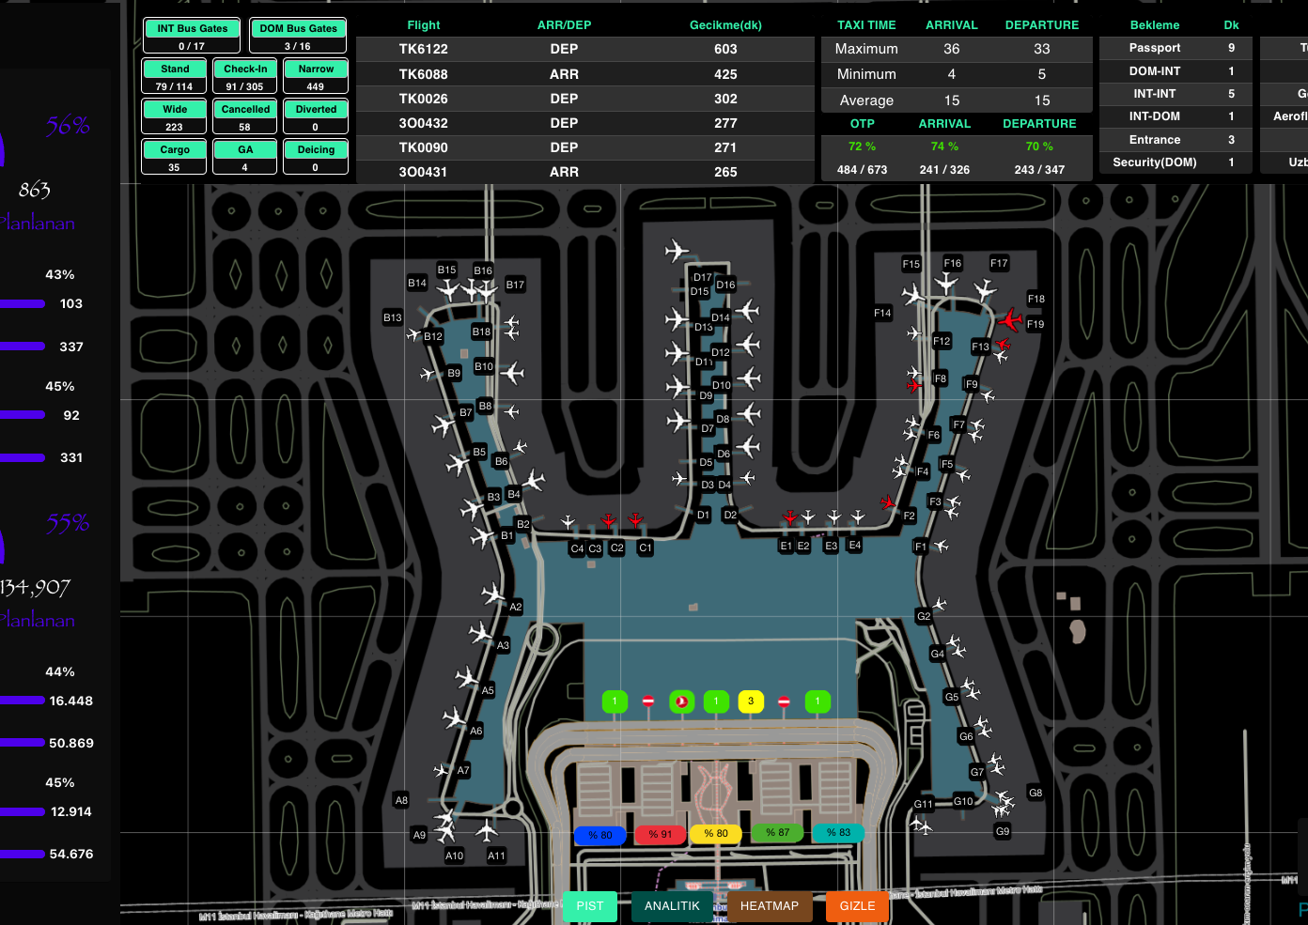
The f1rst data application
Near Real Time Monitoring:
    Flights
    Passengers
    Runway Usage
    Parking Occupancy
    Queues
    Passenger Flows
Analytical Dashboards
Daily Email Updates

Slide 4
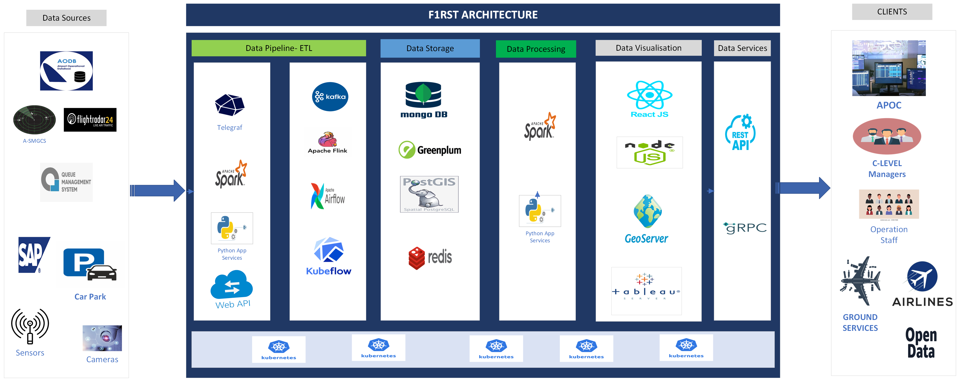
F1rst Architecture

Slide 5
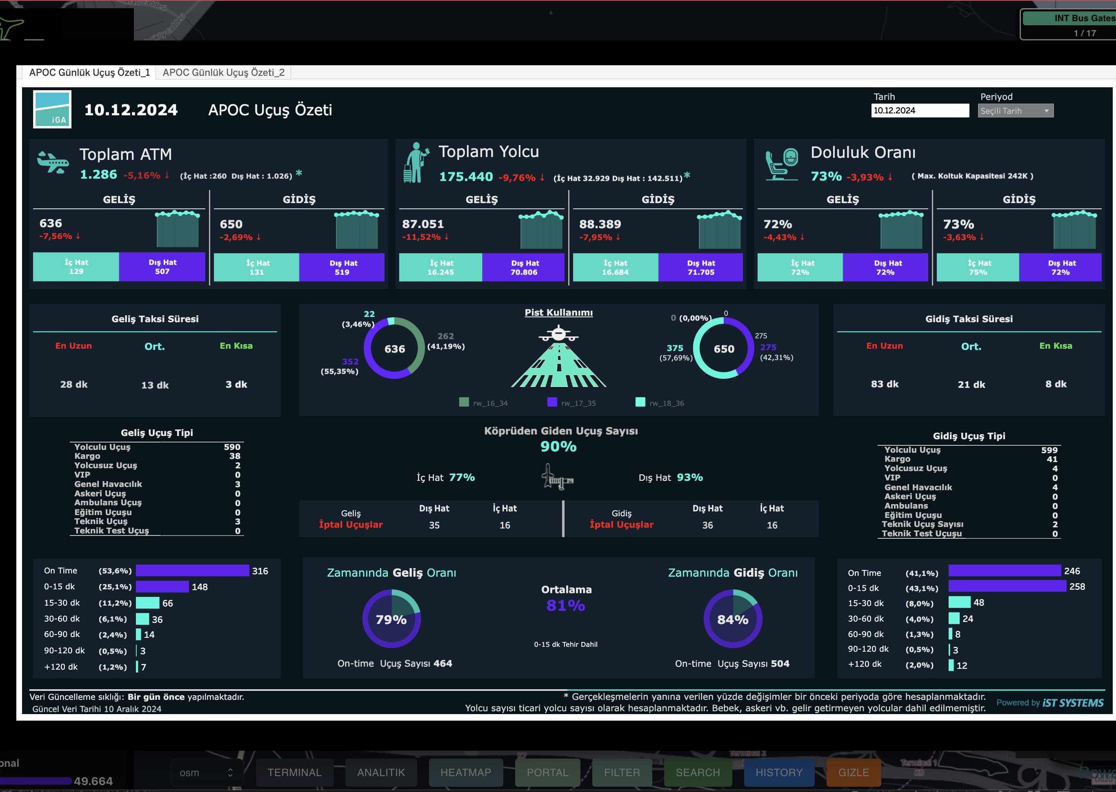
F1rst: New Features
Weather data (wind speed)
Baggage Handling Data
Incident Management Data
Camera Integration
Realtime Holding Flight Analyses
Digital Twin Integration
Events/Notifications
Runway usage analyses
Revenue-driven gate assigments
Security resources optimization
Built-in messaging system
LLM and Agentic AI functionalities

Slide 6
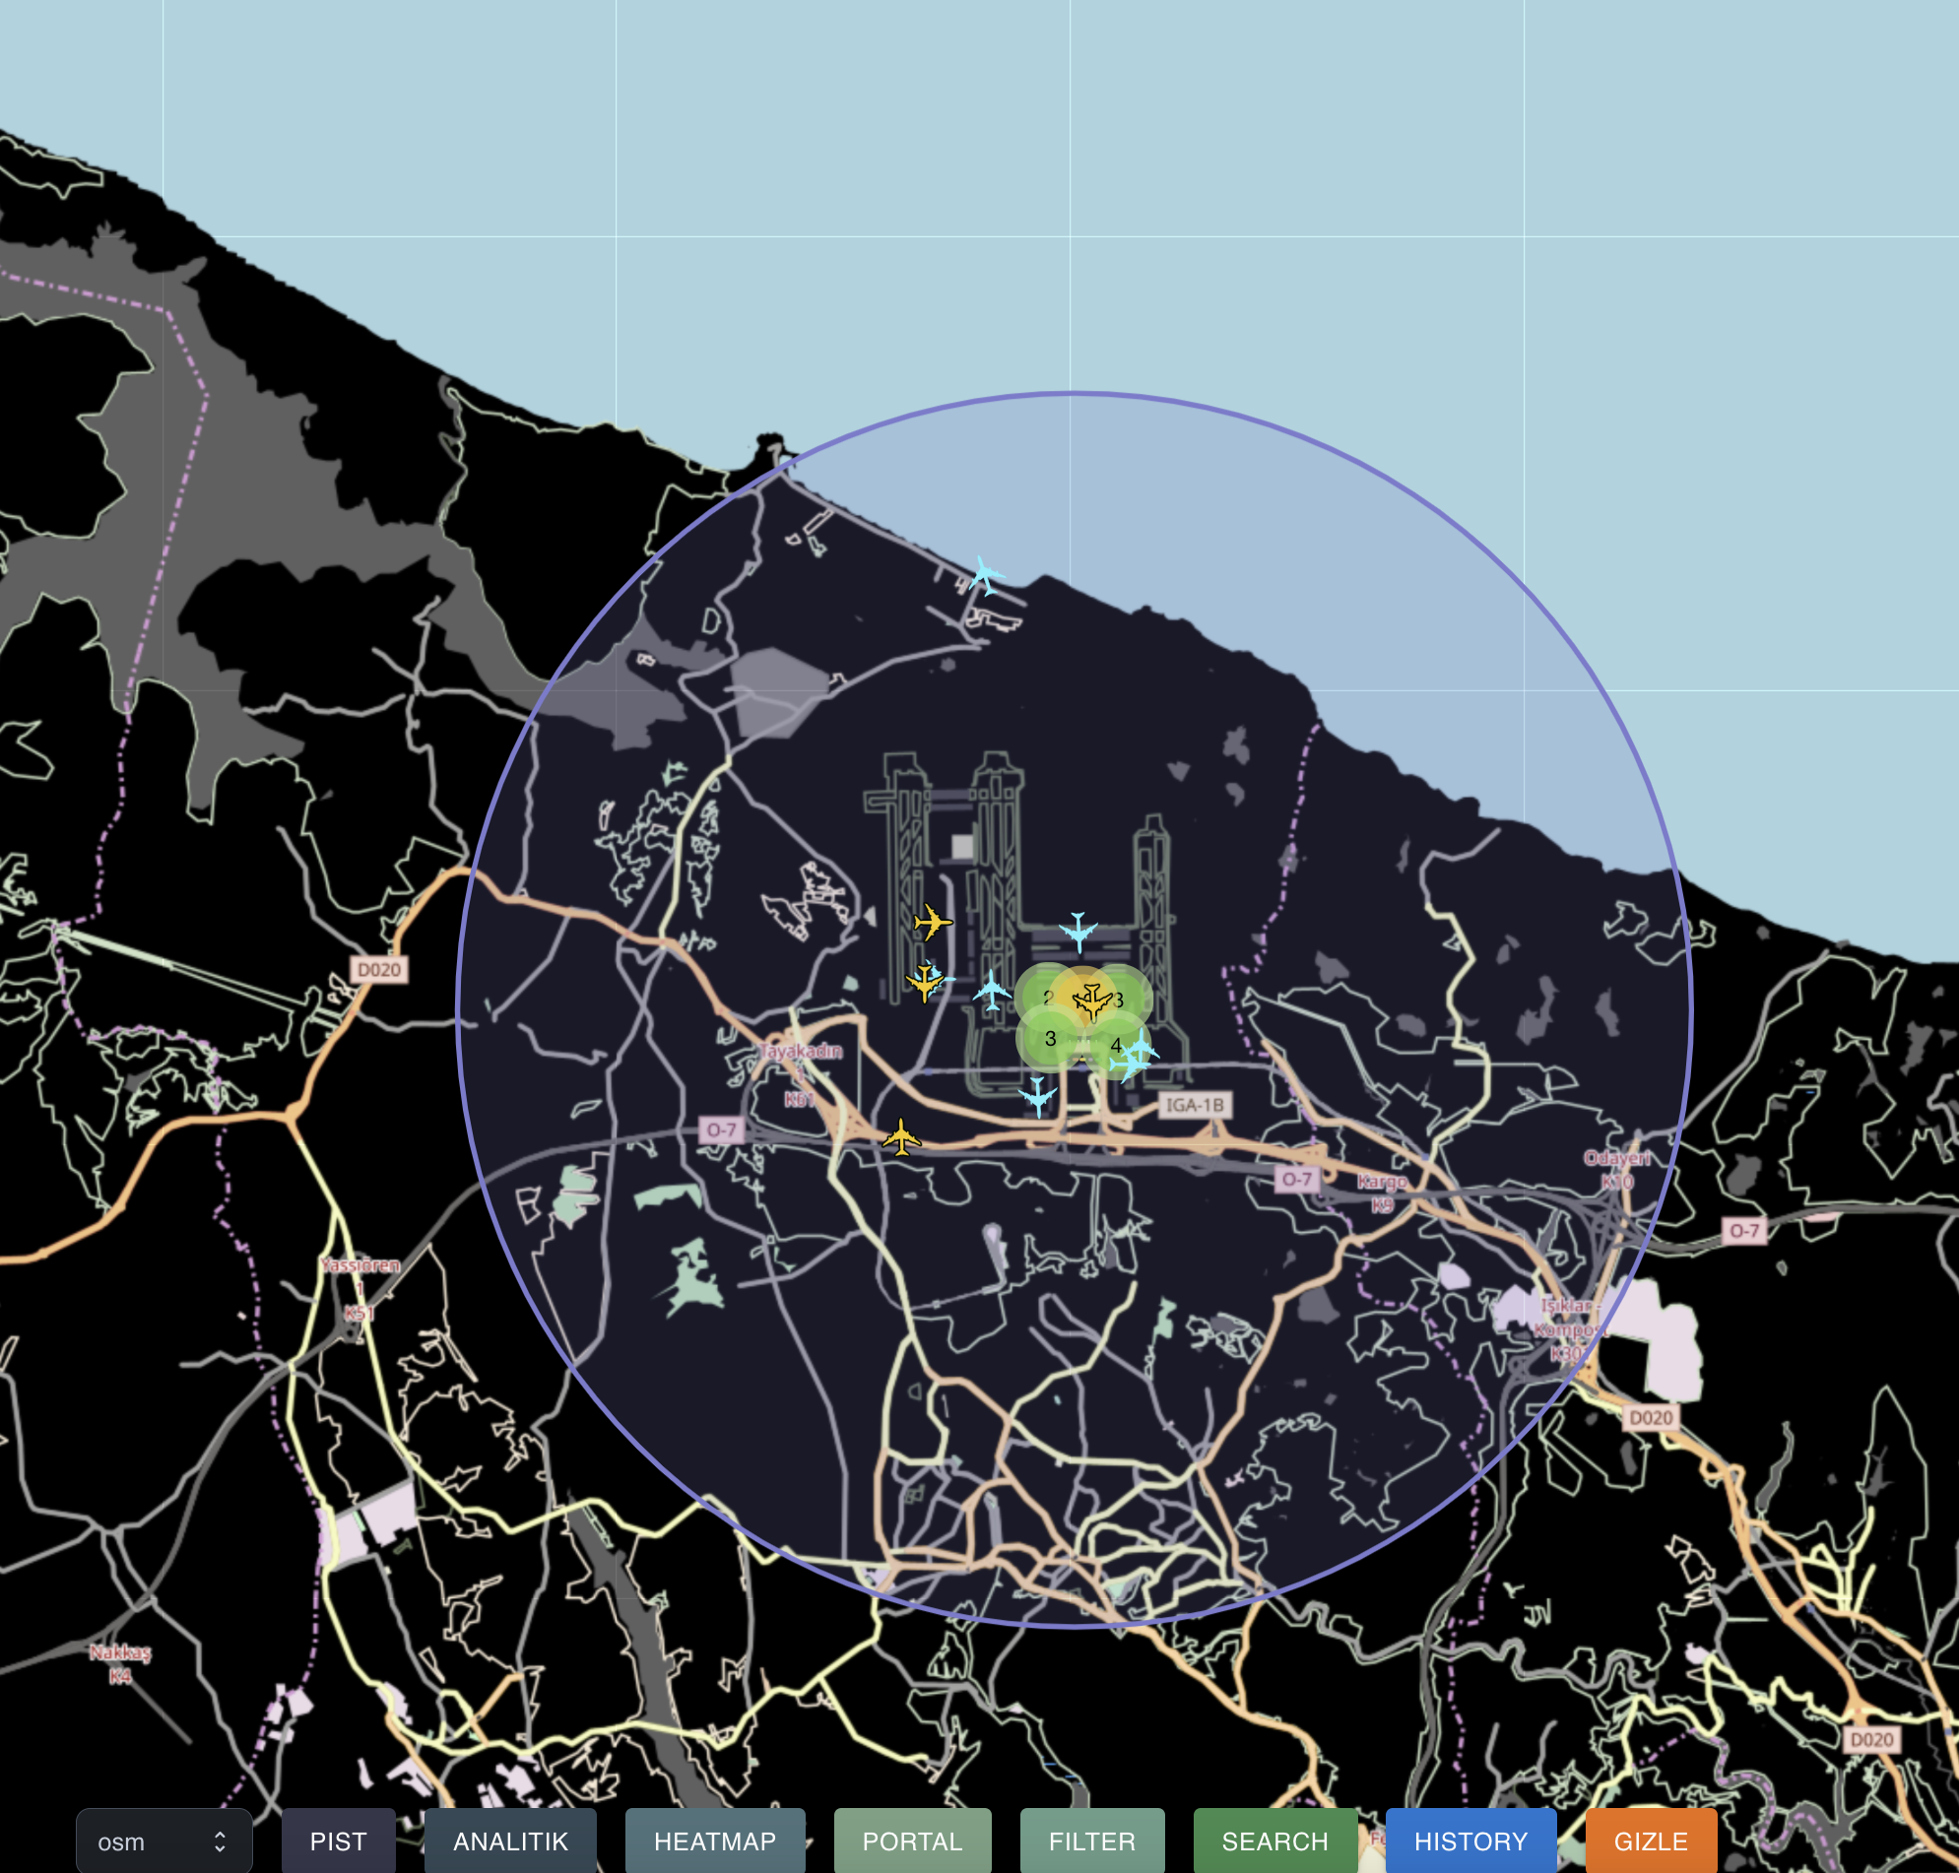
F1rst: Demo
Planned vs. Actual Flight and Passenger Statistics
Ontime Performance and Taxi Time
Real-Time Aircraft Positions
Flight Delays
Waiting Times at Terminal Entrances
Parking Lot Occupancy
Passenger Density Inside the Terminal
Analytical Dashboards
Real-Time Passenger Density in the Terminal
Historical Snapshots of the Terminal's State
Data Filtering
  Monitor data filtered by parameters such as airlines and ground services.
Stakeholder Access
  Stakeholders can utilize the application for insights and monitoring.

