Slide 1



SAW BPV TURNSTILES,
DIGITAL TWIN,
PTS,
IoT-Supported Predictive Maintenance,
E-Translator
PROJECTS

Slide 2

BPV E-TURNSTILE
28X Boarding Pass Verification (BPV) Dormakaba® Turnstile Units successfully went live on Monday, August 11, 2025.
This innovative system enhances both security and operational efficiency by enabling seamless verification of boarding passes during passenger transitions from the land side to the air side. It supports validation via printed or digital boarding passes, as well as national ID cards, ensuring flexibility and reliability.

Slide 3

KEY ACHIEVEMENTS
Enhanced operational efficiency through automation of the boarding pass verification process
Improved passenger experience with faster and smoother transitions
Increased security and traceability via digital logging and real-time monitoring
Reduced manual workload for staff, enabling focus on higher-value tasks
Scalable infrastructure ready for future integrations and expansions

Slide 4
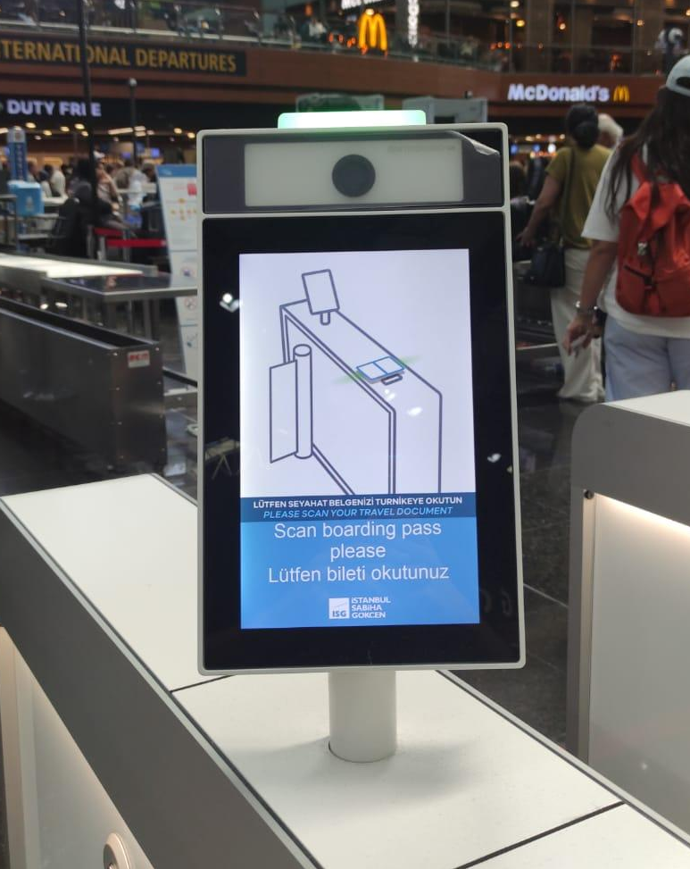

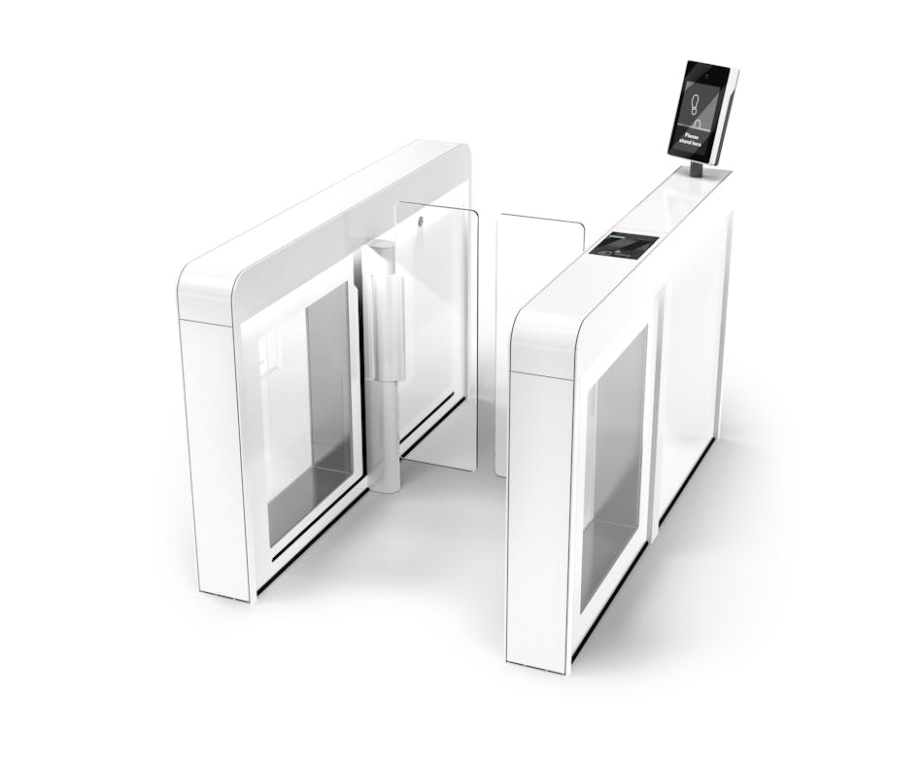
SHOWCASING THE EQUIPMENT (1 of 2)
Make/Model: DormaKaba Argus Air Security E-Gate
Components:
10" LVDS Information-Display(Touch) including Middle light on top of the display as an indicator display
Desko PENTA Multipurpose Scanner Cube Reader
Spinel Biometric Camera (Biometric Ready)
Mini PC with win 11 OS

Slide 5
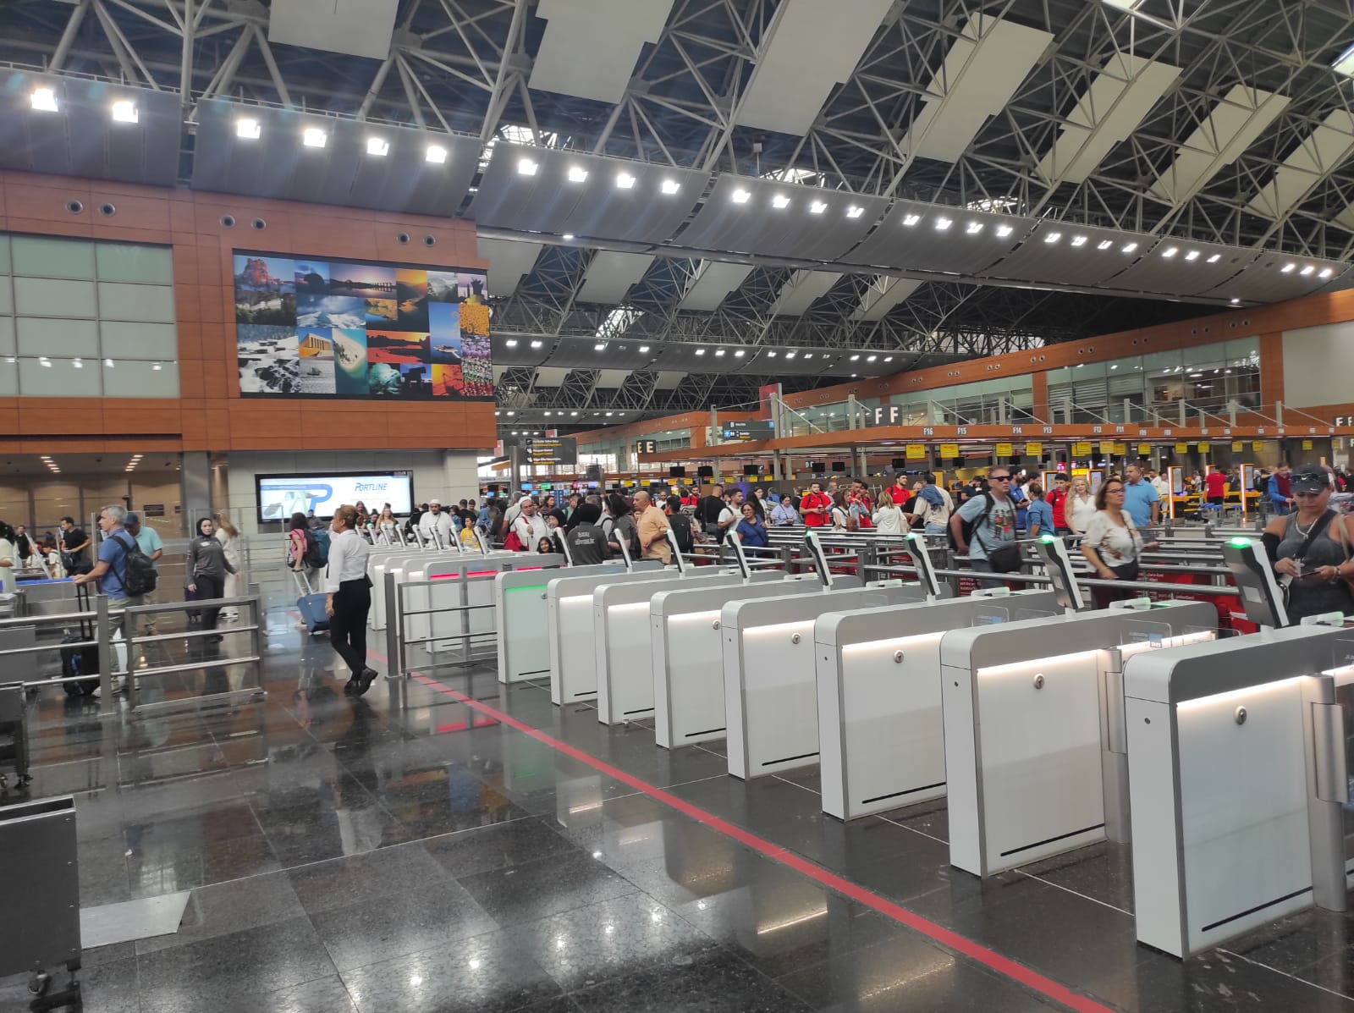
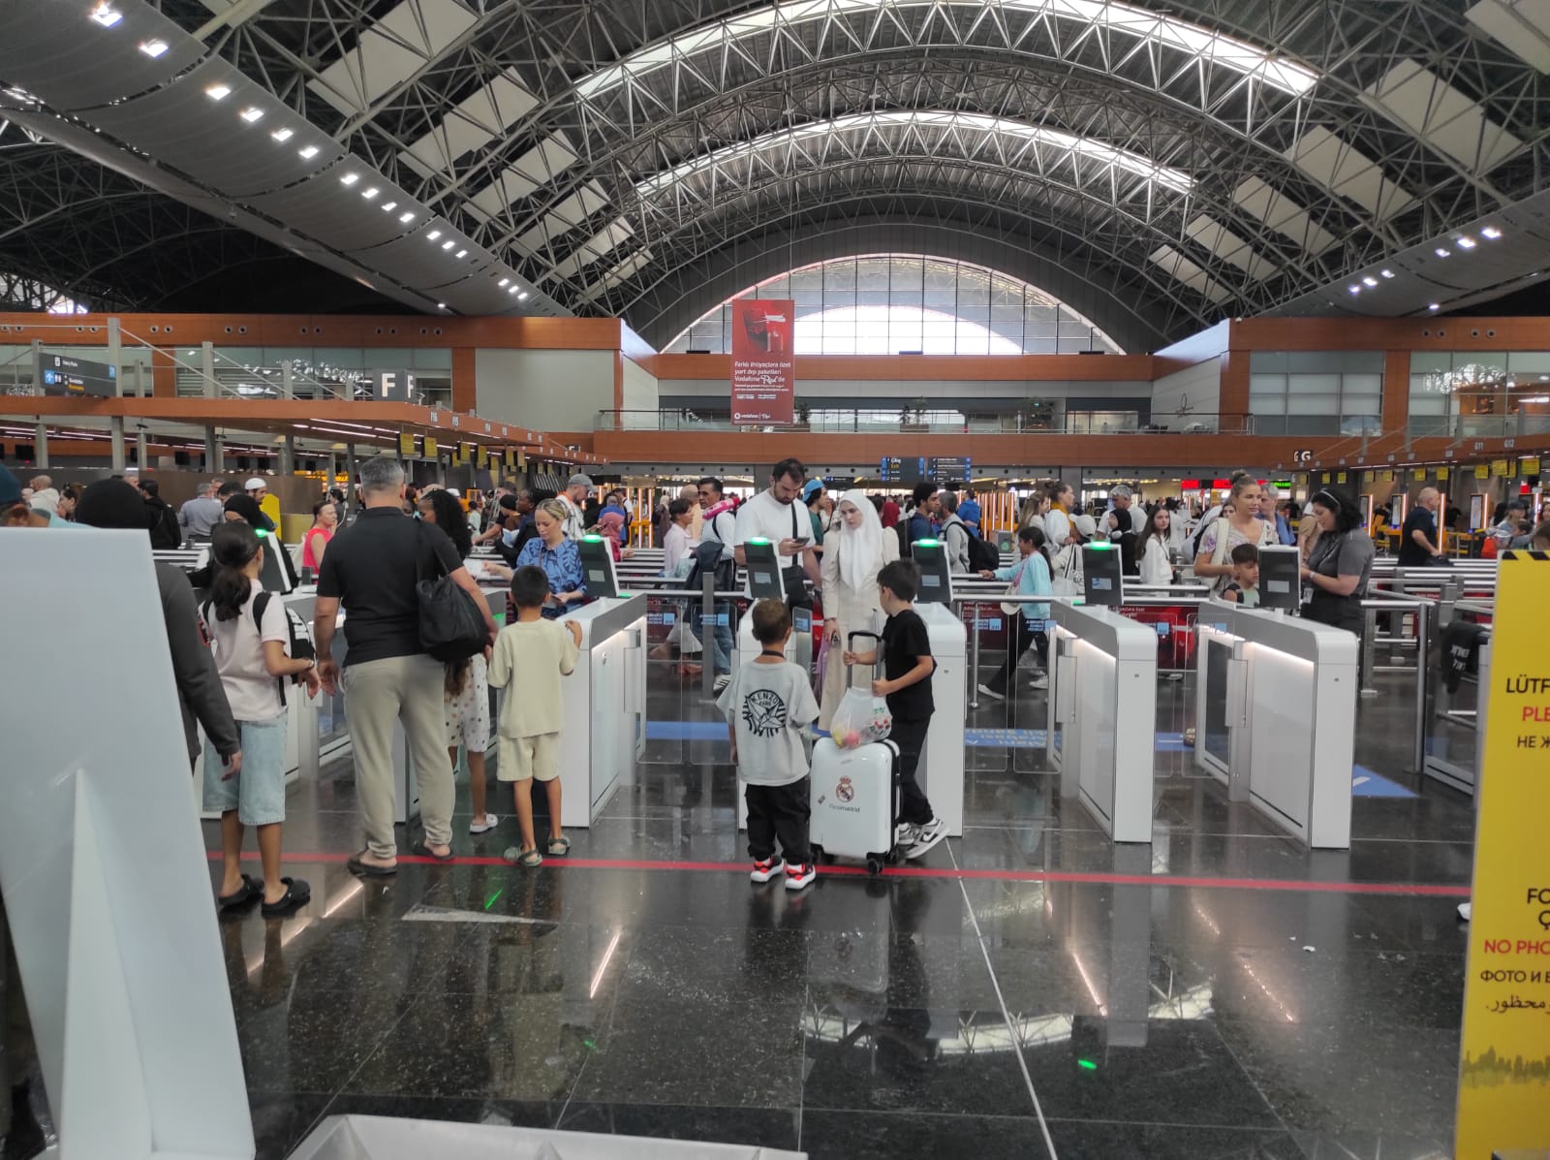
SHOWCASING THE EQUIPMENT (2 of 2)
International Departures

Slide 6
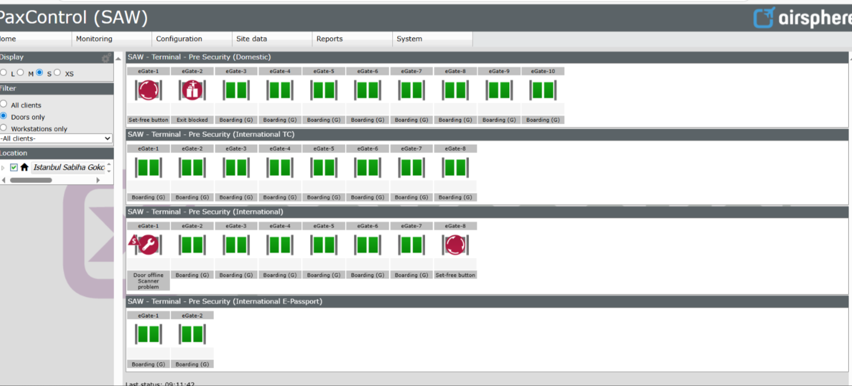
MONITORING DASHBOARD
This dashboard allows you to monitor status, usage, and performance criteria, as well as carry out management tasks.

Slide 7
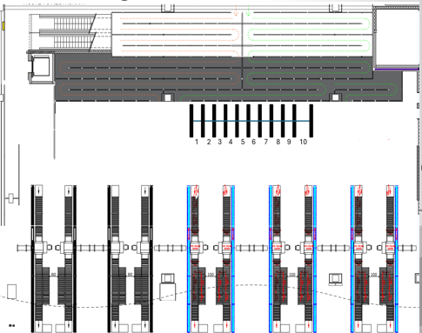
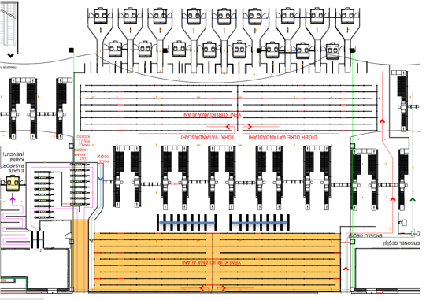
TURNSTILE LAYOUTS
International Departures (18X)
Domestic Departures (10X)

Slide 8


DIGITAL TWIN PLATFORM
The SITA Digital Twin solution assists Istanbul Sabiha Gokcen International Airport in overseeing and tracking both mobile and fixed equipment, while providing real-time operational data display. This enhances operational transparency and enables more effective, realistic supervision and monitoring of the airport.
The solution consists of the following modules/features:
1. Airport Map (3d Model)
2. Infrastructure View
3. Passenger Flow (Xovis)
4. Historic Playback
5. Alert view for KPI monitoring
6. Mobile Device Support (Collaboration channel)
INTERFACES
1. SAW Airport Management System (AMS) “Phase 1”
2. XOVIS – Passenger Tracking System “Phase 1”
3. BMS
4. Escalators & Elevators

Slide 9
KEY ACHIEVEMENTS
1. Operational Efficiency
Real-time monitoring of flights, passengers & apron.
Proactive decision-making
Early detection of delays & conflicts.
Ability to review past operations through a playback function.
2. Resource Optimization
Smarter use of gates, stands, carousels & counters
3. Passenger Experience
Identify potential congestion areas in advance, improve passenger satisfaction.
Proactive intervention before congestion occurs.
4. Data Integration & Visualization
Aviation systems (AMS, Xovis, AODB) on one screen.
Instant operational awareness through visualization.
5. Predictive Analytics
Forecast delays, congestion & resource needs.
6. Strategic Advantage
Contribution to smart airport vision.

Slide 10
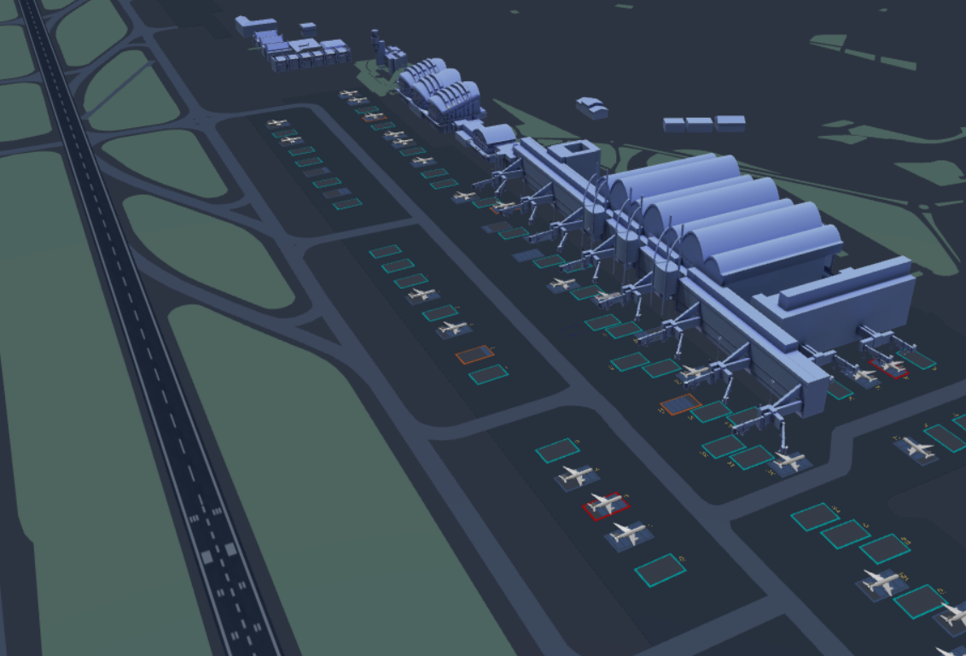
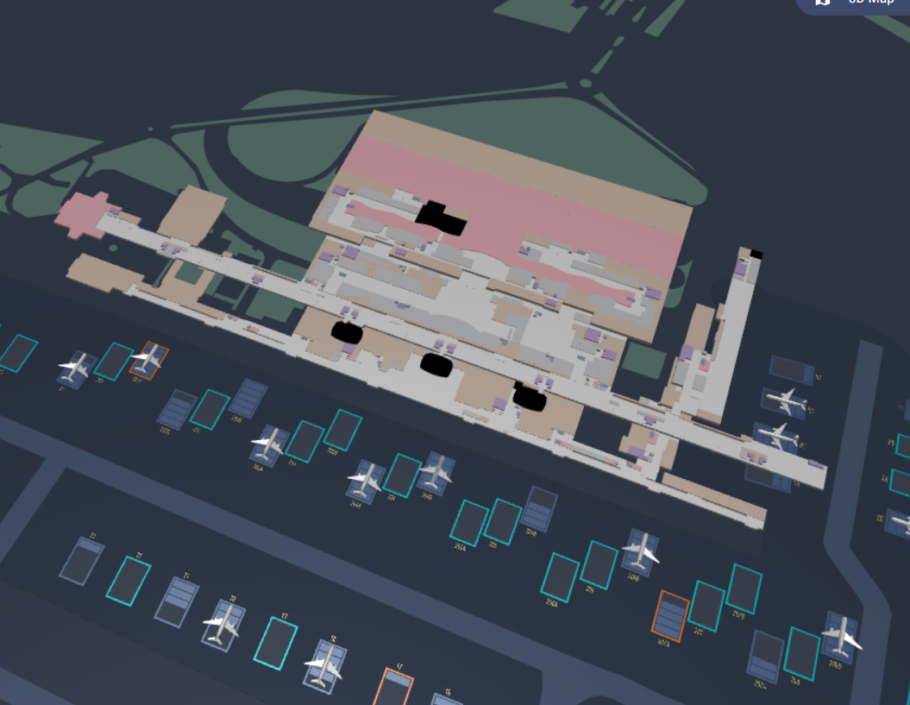
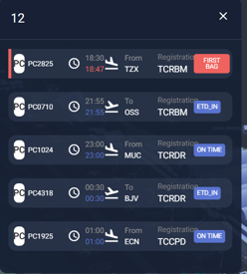
VIEWS FROM DIGITAL TWIN & LIVE DEMO

Slide 11
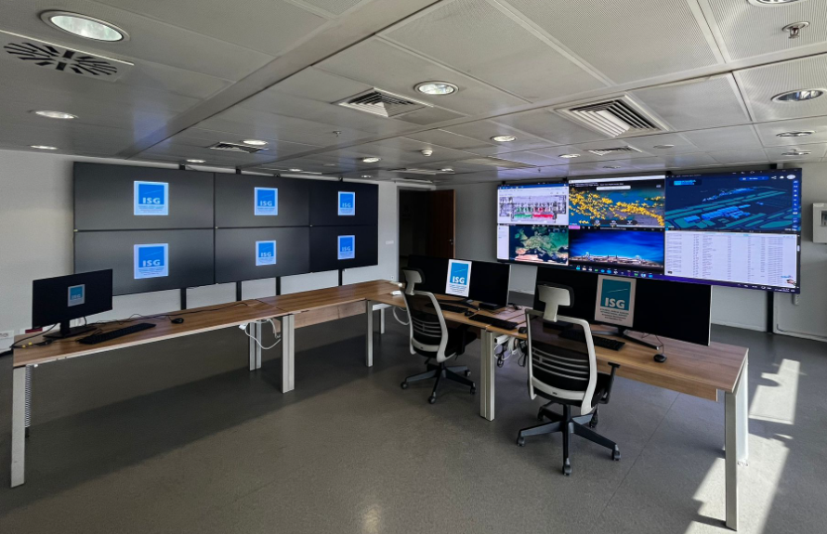
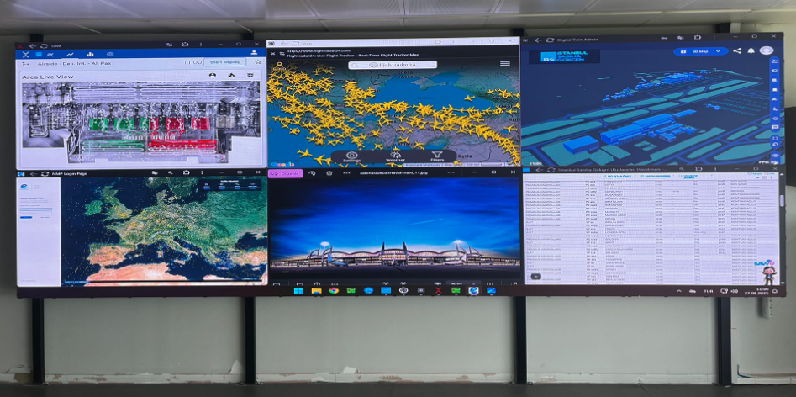
TERMINAL OPERATIONS CENTER
The Terminal Operations Center (TOC) Room, established in Q3 2025, is scheduled to become fully operational in October 2025. Its primary objective is to serve as a centralized hub for terminal operations management, enhancing both operational efficiency and overall performance. The Digital Twin solution will be the backbone of the approach.

Slide 12
IOT-SUPPORTED PREDICTIVE MAINTENANCE
Sawsmart Project covers predictive maintenance for critical equipment within the Baggage Handling Systems (BHS) at Istanbul Sabiha Gökçen Airport. Any malfunction in BHS can cause operational disruptions and decrease passenger satisfaction. The project aims to ensure uninterrupted and safe system operation.

Slide 13
IMPLEMENTATION & TECHNOLOGY
30 sensors provided by Sensemore have been installed at critical BHS points.
These sensors collect data such as temperature, vibration, and sound.
They detect changes at levels beyond human perception, identifying potential faults early.
Data is monitored and analyzed on a digital platform; anomalies trigger alarms and regular reports are sent to relevant teams.

Slide 14
INNOVATION & AI-POWERED PREDICTIVE MAINTENANCE
The core innovation of the project is the predictive maintenance approach.
Unlike traditional maintenance (performed after a failure or at set intervals), sensors in this project detect faults at the earliest sign—before a breakdown occurs.
AI-powered real-time analysis monitors temperature, vibration, and sound data, sending instant notifications and alarms to technical teams even for the smallest anomaly.
This enables continuous system operation, prevents major issues before they arise, and ensures maximum reliability and efficiency for BHS.

Slide 15
PASSENGER SERVICES PERFORMANCE TRACKING SYSTEM (PTS)
The Passenger Services Performance Tracking System (PTS) is designed to monitor and analyze passenger journeys at Istanbul Sabiha Gökçen Airport.
PTS tracks queue times and service durations at key terminal points, providing real-time data for both operational teams and management.
This system enables the airport to identify bottlenecks, optimize resource allocation, and improve overall service quality.

Slide 16
KEY ACHIEVEMENTS
Enables data-driven improvements in passenger experience and airport operations.
Supports digitalization and process optimization across the terminal.
Helps increase passenger satisfaction and operational excellence as part of the broader SAWSmart vision.
Regular performance reports and analytics allow for continuous improvement and proactive decision-making.

Slide 17
E-TRANSLATOR
The e-Translator project is designed to provide fast and accurate translation services for airport operations and passenger communications.
It enables real-time translation between Turkish and multiple foreign languages, supporting both written and verbal interactions.With e-Translator, airport staff can assist international passengers more effectively, ensuring clear communication and enhancing the overall travel experience.

Slide 18
KEY ACHIEVEMENTS
Improves service quality for international passengers.
Reduces language barriers in daily airport operations.
Supports both text and speech translation in real time.
Contributes to the digitalization and modernization of airport services.

Slide 19
2025
Thanks !

