Slide 1
Predictive Maintenance
PDM

Slide 2



Pdm (predictive maintenance)
Problem & Usecase Description:
Due to high value end-product and complex production requirements even 5 minute unplanned downtimes are very critical.
Lifts and converyors in the production area shop lead to unplanned downtimes despite traditional preventive maintenance measures
High costs
Downtimes can be as long as 5-6 hours
Classical PdM approaches are not scalable
The PdM project aims to predict equipment failures in various assets, reducing overall downtime and increasing operational efficiency.

Slide 3
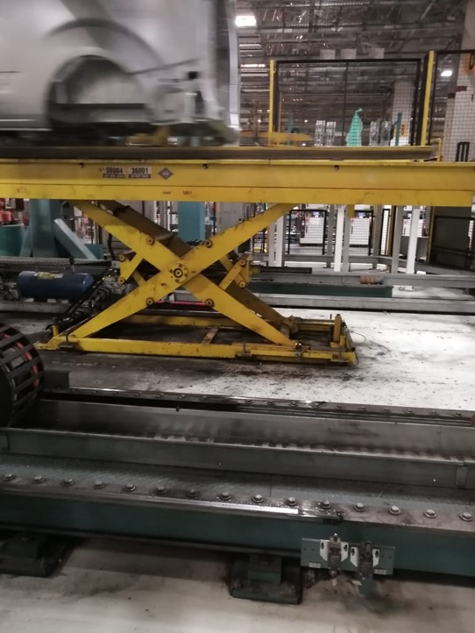
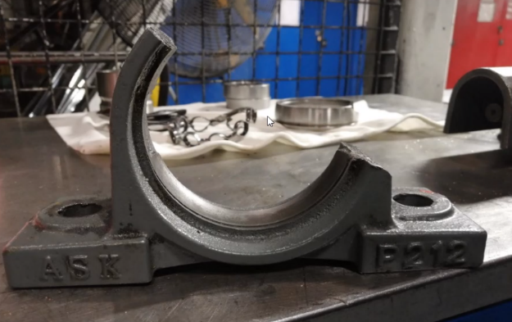
PDm
Problem Example:
The bearing of the lift at the 6x70 station was broken.
Lift
The equipment failure caused about
3 hours of downtime

Slide 4
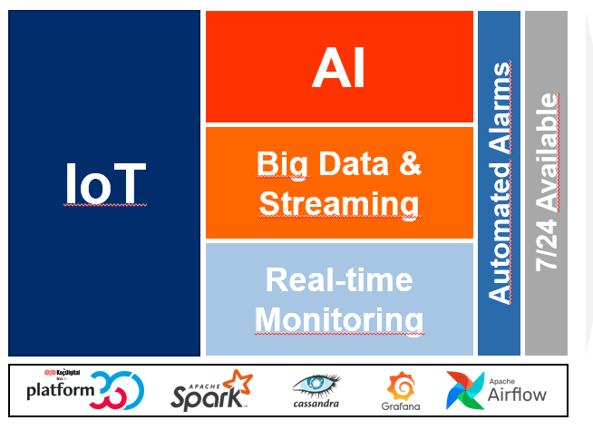
Pdm
IoT data collected on FO MIS is processed via advanced analytical tools and upcoming failures are predicted hours or even days ahead of actual failure
Solution:
Technology:
Plug & Play: No additional IoT device or hardware installation is required to obtain data
Simple Data Features: Only electrical current values (sampled at 500ms) or similarly simple data obtainable from asychronous motor drivers are used
Adaptable: Methods can be extended to different assets and failure types

Slide 5
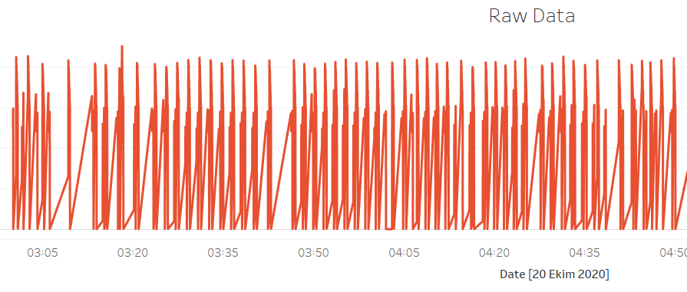

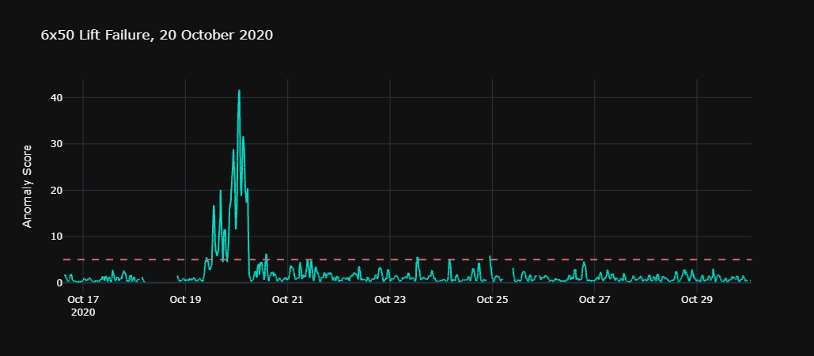
PDM
«Everything should be made as simple as possible*»
Raw Electric Current Data
Low frequency data
Fast model training
Software based solution
Advanced analytics:
Raw data converted
into anomaly scores
Failure detected 5 – 8 hours ahead of time
* Albert Einstein

Slide 6
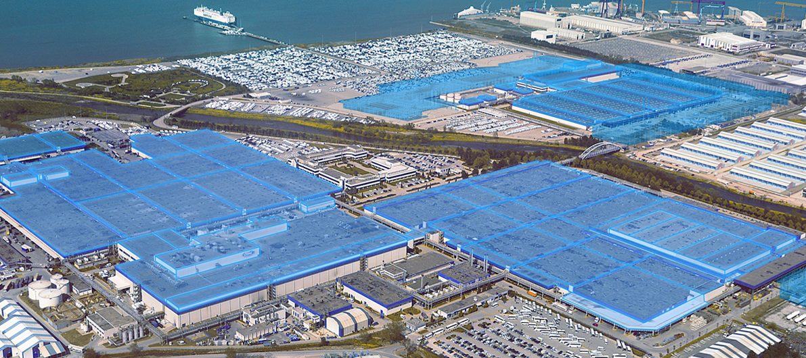

Pdm
Scope:
50 Assets
90 Assets
Connected
Working on
4
17
Paintshop
Assets
9
22
Assets
Assembly
37
51
Welding
Assets

Slide 7
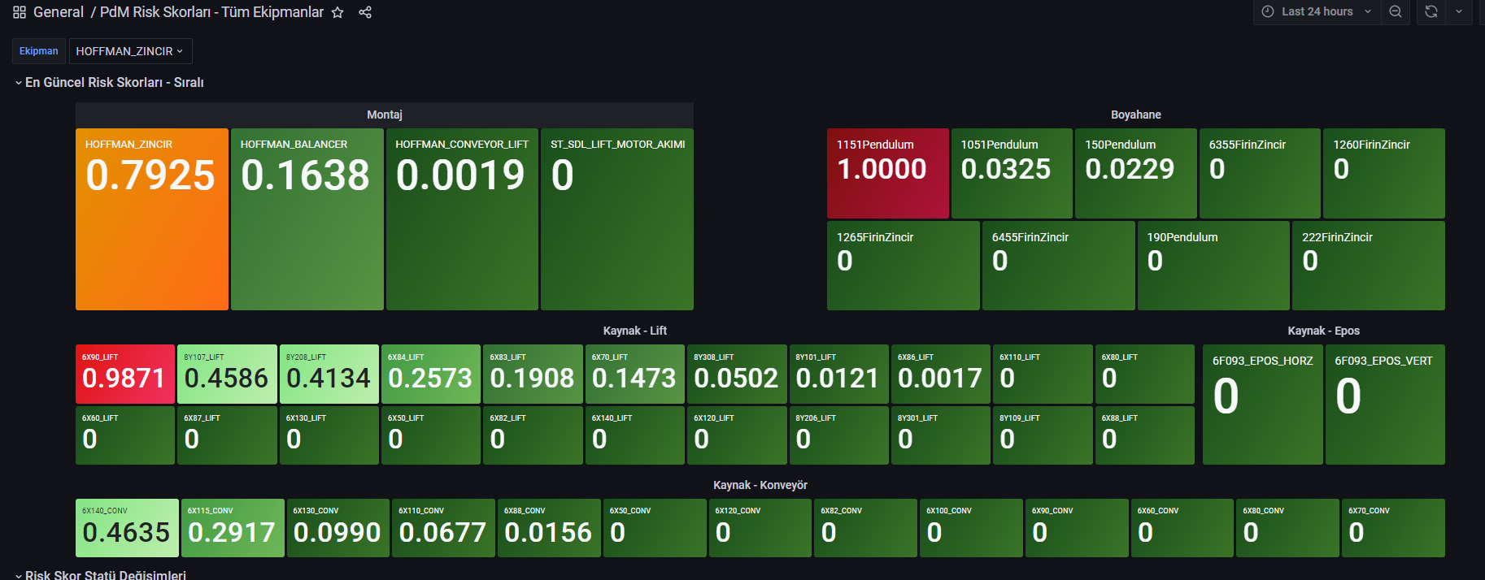
Pdm
Usage:
It can be viewed as a summary of the risk score of all equipment.

Slide 8
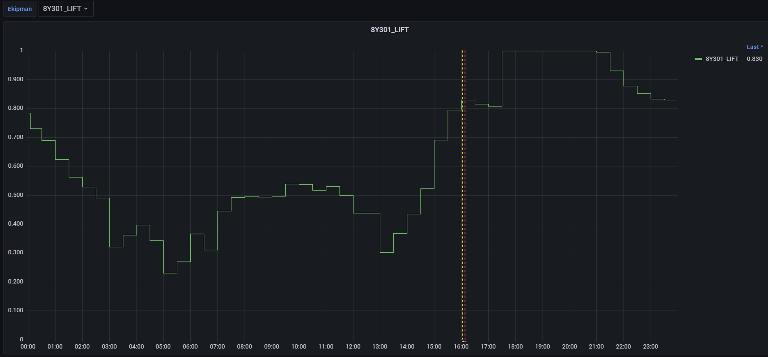
Pdm
Usage:
The detail of the historical risk score of the selected single 1 equipment can be examined hourly/daily at the requested time.
Example: 8Y 301lift motor 24-hours data

Slide 9

Pdm
Project Savings:
  Minimize unplanned downtimes and improve asset availability
  Increase OEE
  Maximize mean time between failures (MTBF)
  Doing the most efficient maintenance and data-driven planning
  Autonomous control of equipment condition
  Reducing spare-parts cost

Slide 10




Pdm
Results:
27 Breakdowns were eliminated
  Increased overall output without additional investment on capacity.
  Maintenance employee engagement increased.
  Paper-based data collection has been eliminated on KPI calculation and plant monitoring.
  Automated processes have increased employee productivity.
4374 Cars
10 Days
High Anomally
Score
Automatic
Warning System
Data-driven
Planning
Maintenance
Check
1 day = 3 shift
10 days = 30 shifts
Per shift cost = 15K €
30 shifts = 450K €
+ 450K €
Feedbacks

Slide 11
pdm
THANK YOU !
QUESTIONS ?

