Slide 1
Çalışma Alanı Güvenliği ve Kalite Kontrol Süreçleri
için Ölçeklenebilir Yapay Zeka Platformu
Scalable AI Platform for Industrial Workplace Safety and Quality Control Processes
Ford Otosan / Enes Uzun
Robolaunch / Tunahan Ertekin

Slide 2
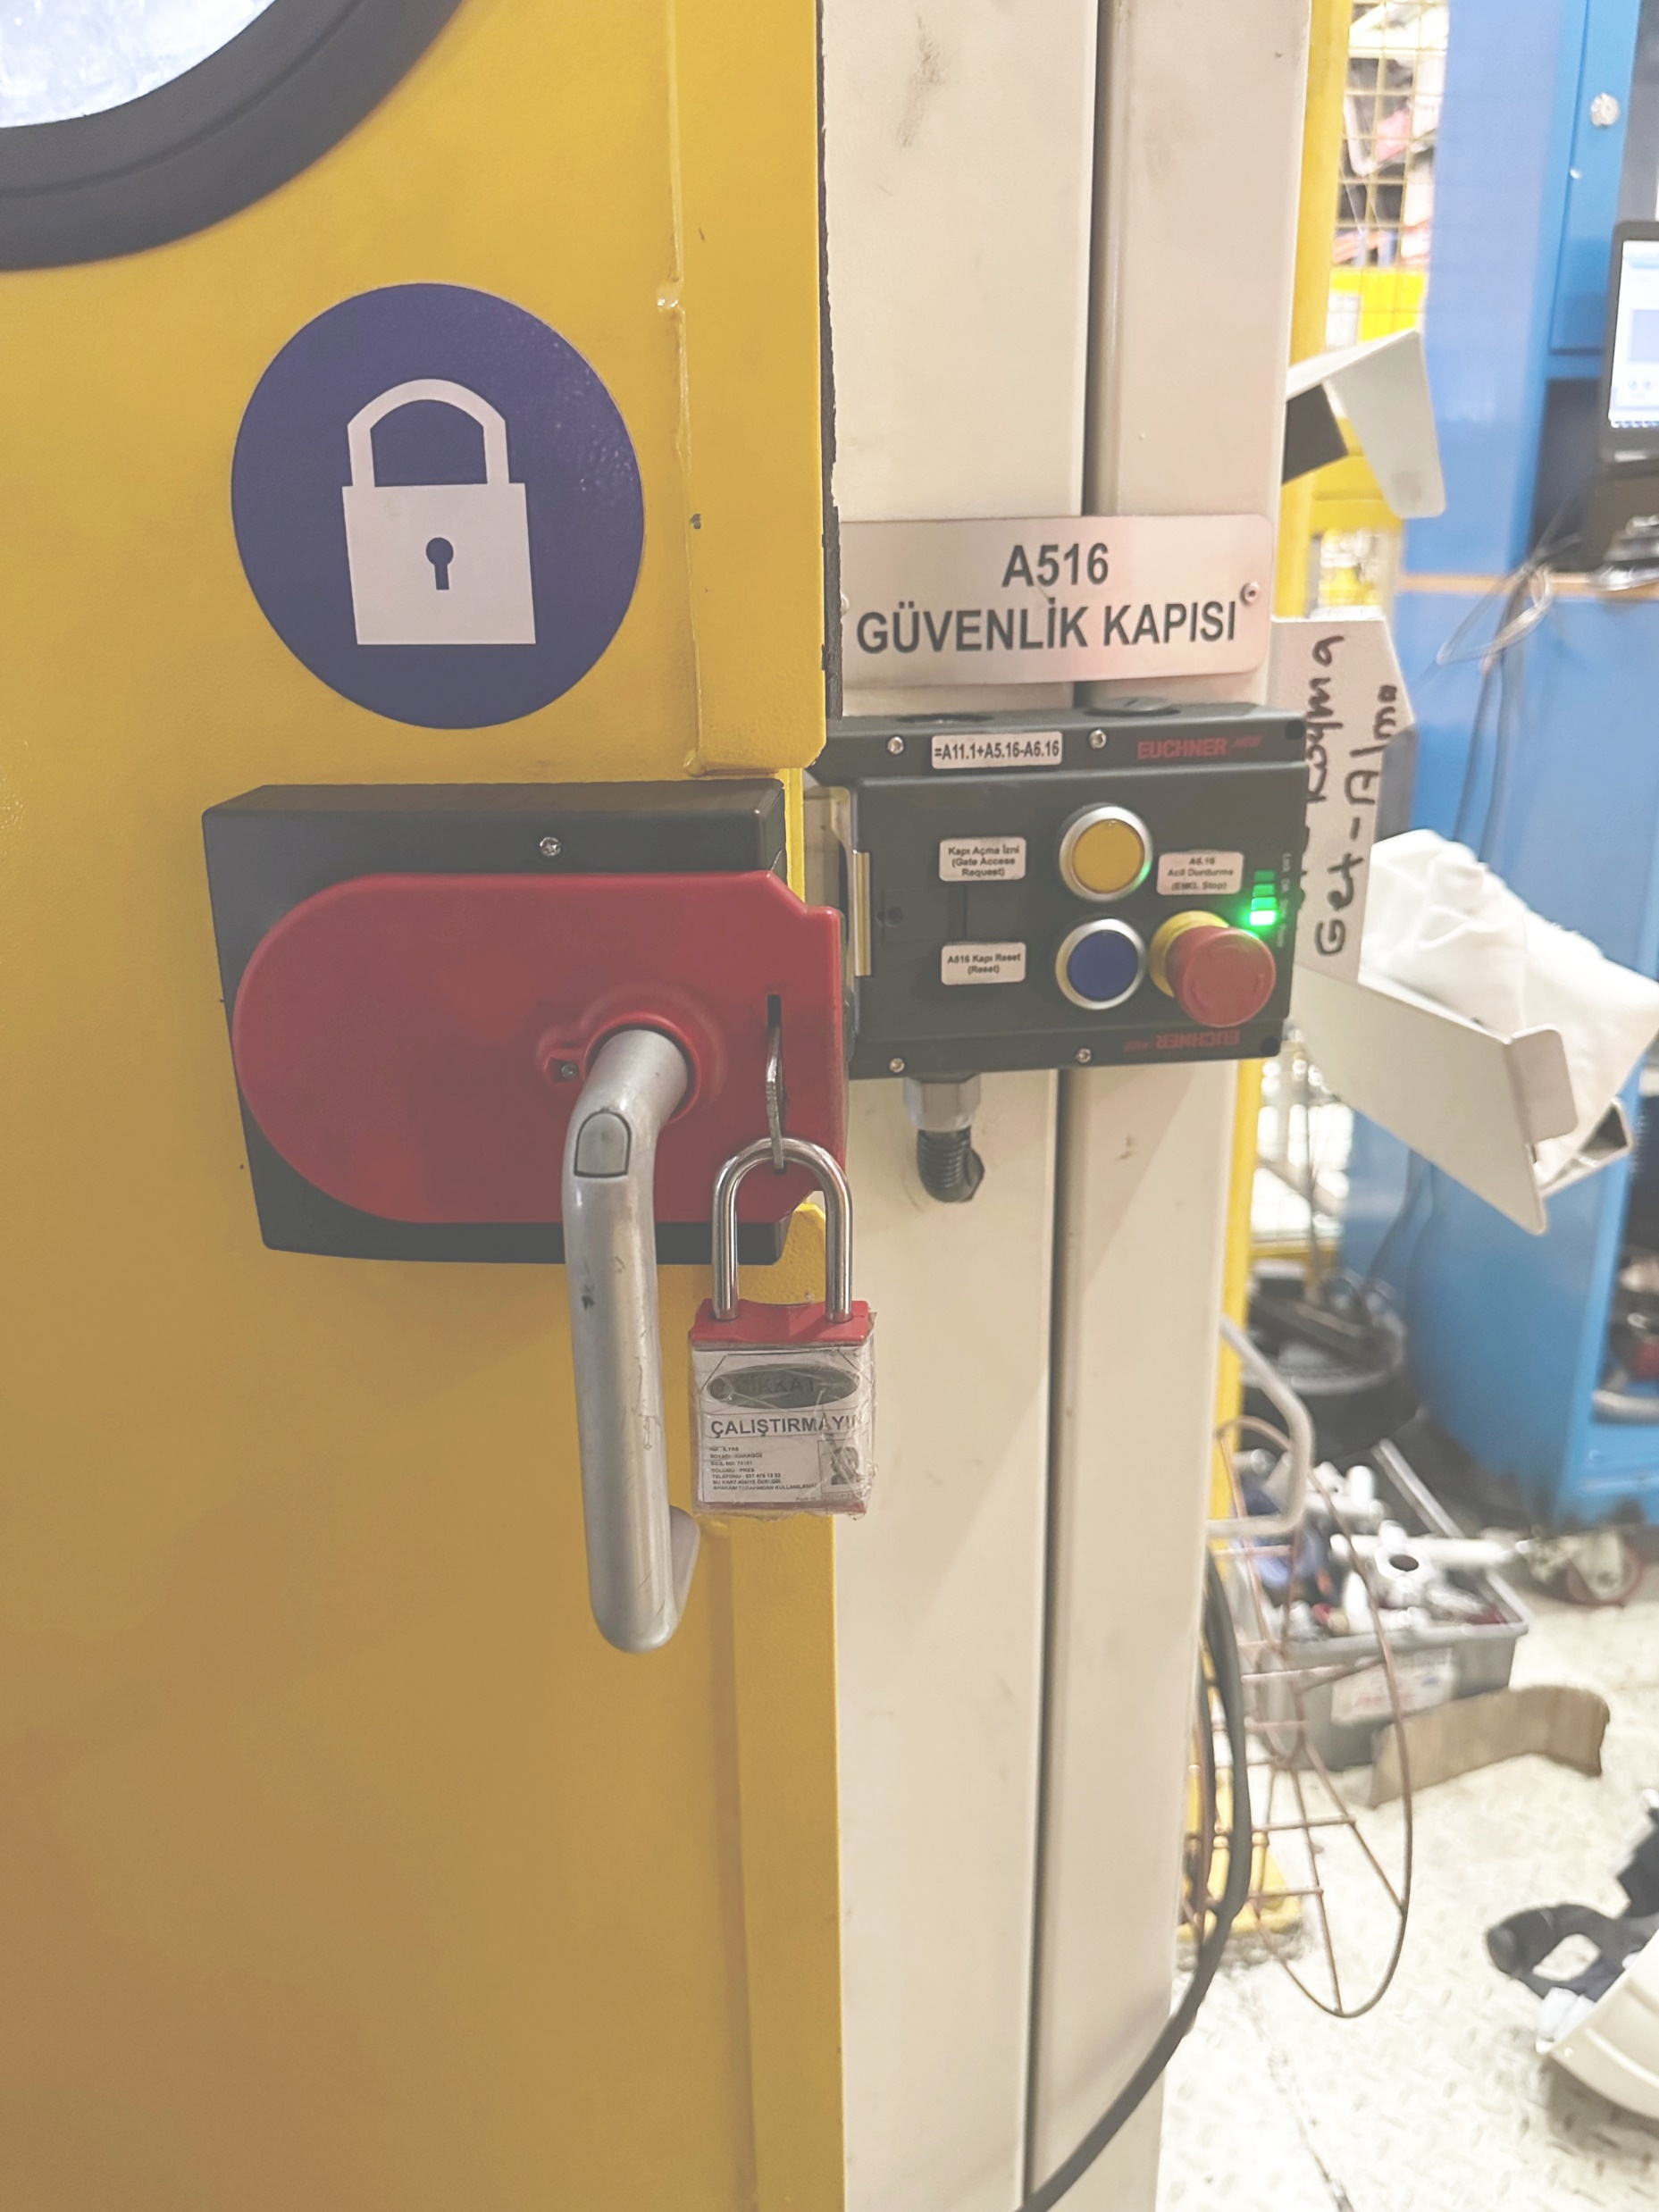
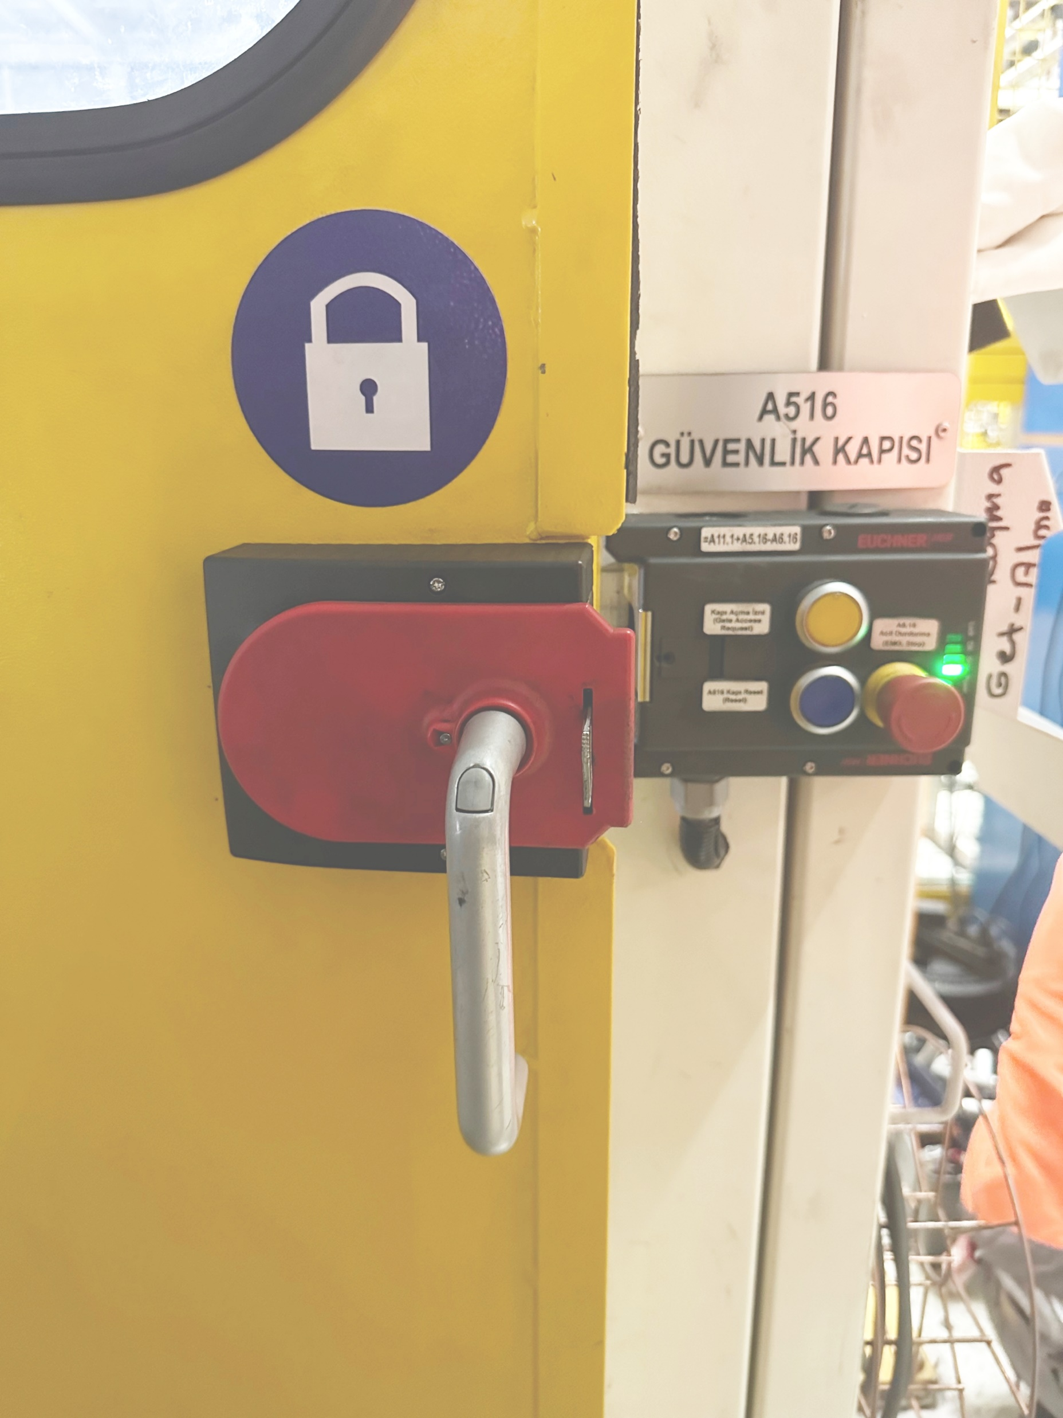
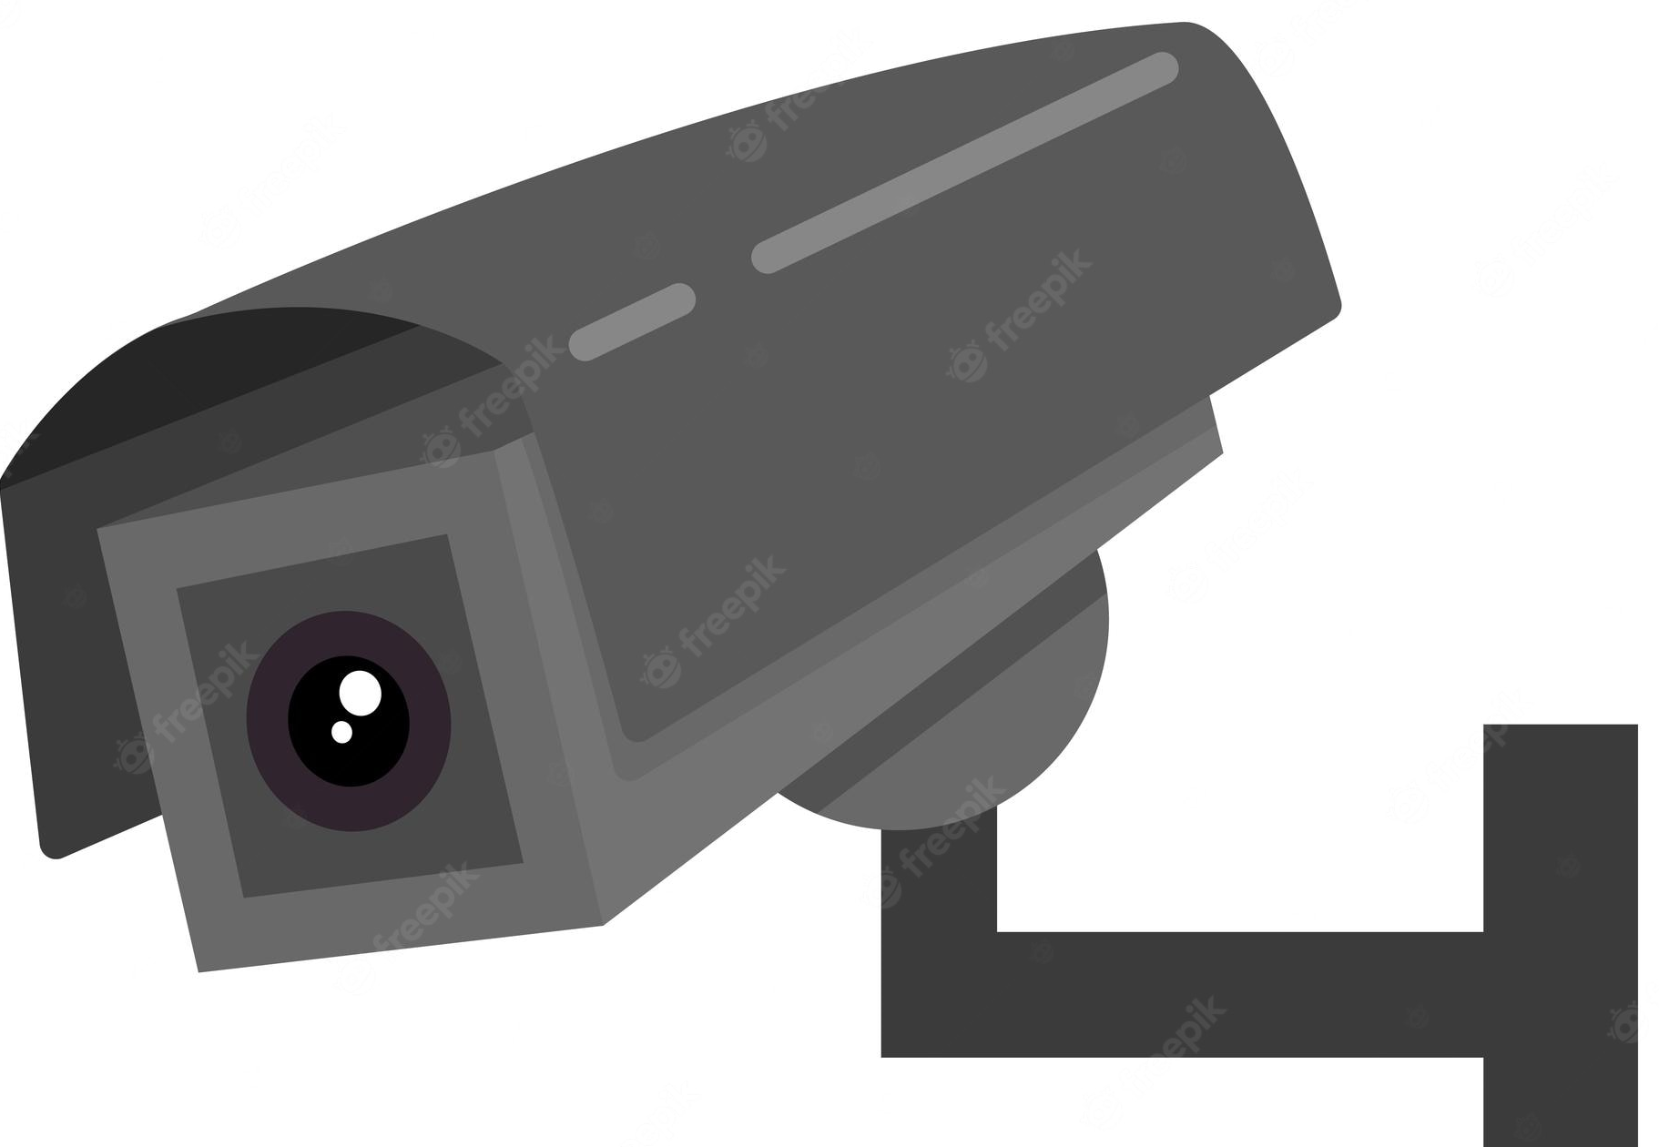
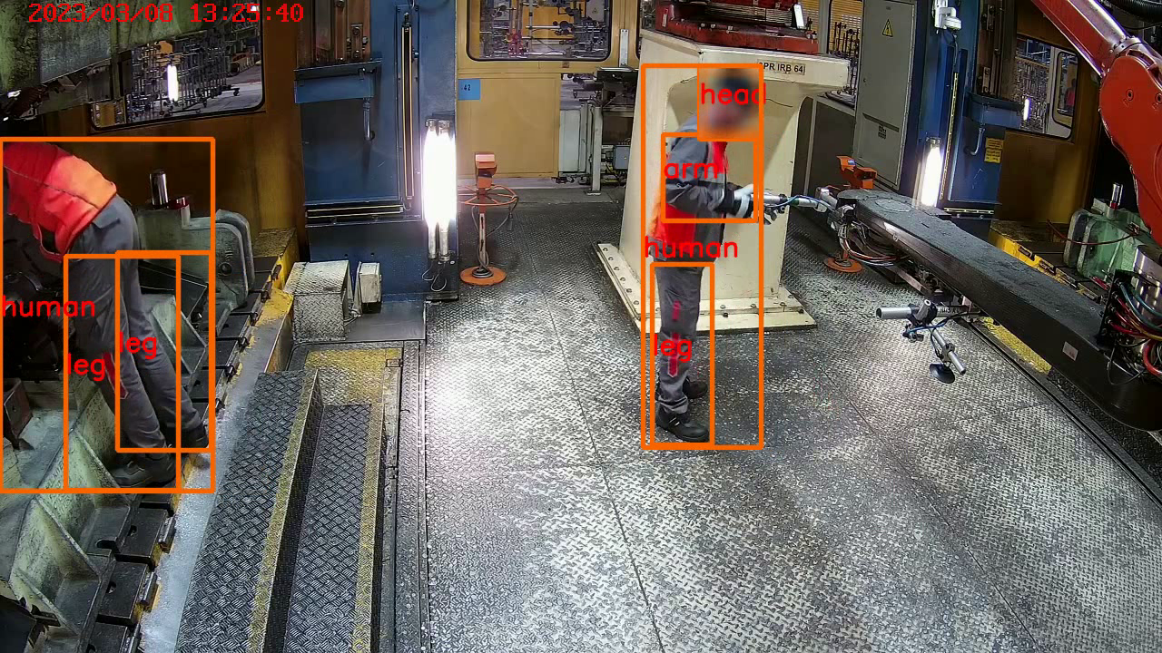

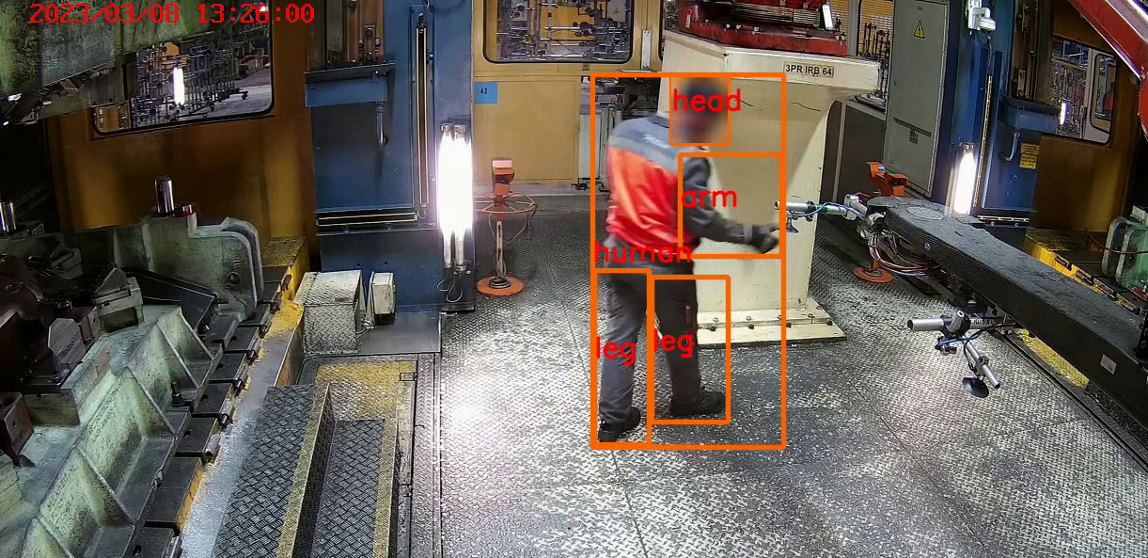
Brief Summary of the Presentation
Humans can forget to put padlocks on.
Humans can be in the stamping line!
A true story in 60. automated stamping line at Kocaeli Plant
Before Project
Padlock put on the gate. (as a human count)
Maintenance operations
(automated stamping line)
End of maintenance
(humans remove padlock)
Automatic line start button pressed
START
After Project
Is human detected
by Vision system ?
No
Yes
Stop line!
Send e-mail
Audio alarm

Slide 3
Key Points Supporting the Presentation
Our solution - Scalable AI Platform for Industrial Workplace Safety and Quality Control Processes
Reducing safety risk – Before & After
Safety Control Systems (Easy to Replicate. Modular.)
Quality Control Systems (High Accuracy AI Models)
GPU Accelerated Scalable Artificial Intelligence Platform
    MLOPS Solution: From Development to Production
    End to End AI Inference Pipeline
  Frequently asked questions (last page)

Slide 4
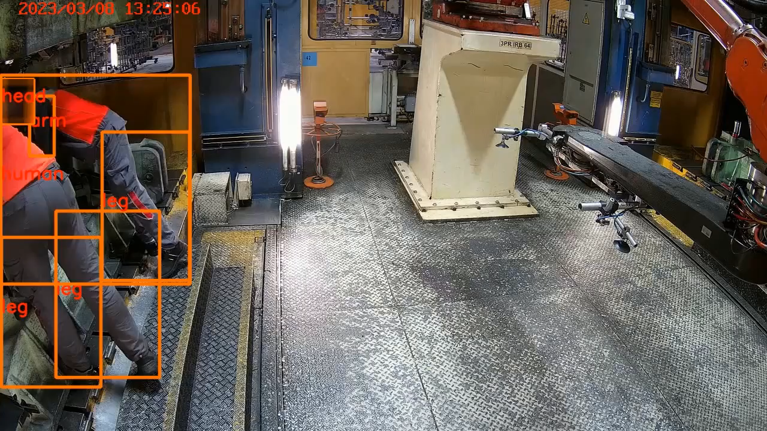


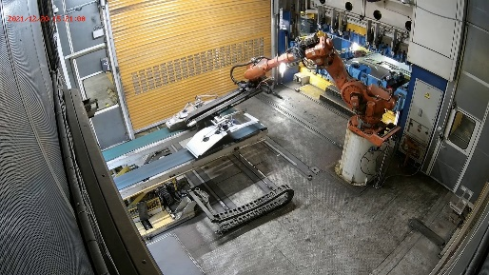




1. Our solution Scalable AI Platform for Industrial Workplace Safety and Quality Control Processes
Human detected!
Emergency Stop
Process real-time camera images
Audio & Visual warning!
Human detection with AI as a Visual output (60. stamping line)
Sample product specification / Line 60 Stamping Line
21 CCTV cameras (no blind spots)
Emergency stop / rapid response time (max 400 milliseconds)
Stores video files for 3 months.
Real-time monitoring and processing
Audio & Visual warning
Useful Human user Interface
Send e-mail
Send message

Slide 5
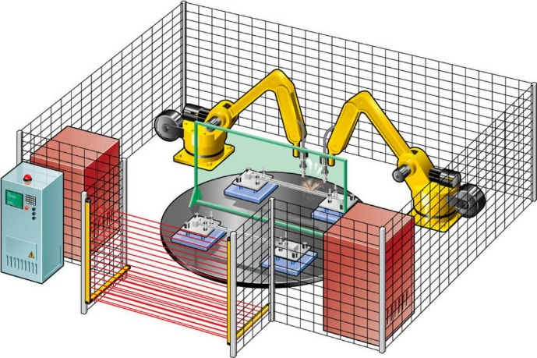
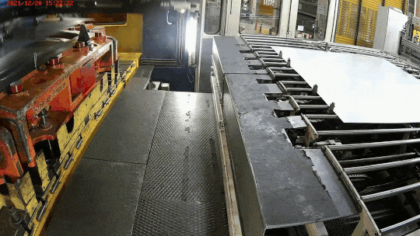
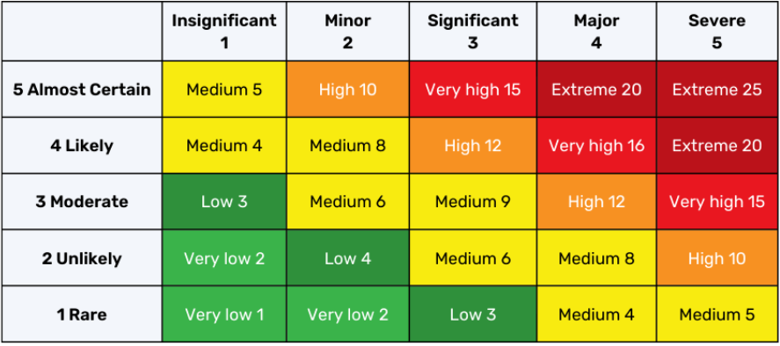
2. Reducing safety risk – Before & after
Safety light curtains
Risk matrix: Fatality risks! (before)
Safety light curtains provide safe monitoring of hazardous areas. However, automatic production systems can start while employees are inside which could result in fatal injury.
People do forget especially when they are tired!
But computers NEVER get tired and NEVER forget!
Be reduced!

Slide 6
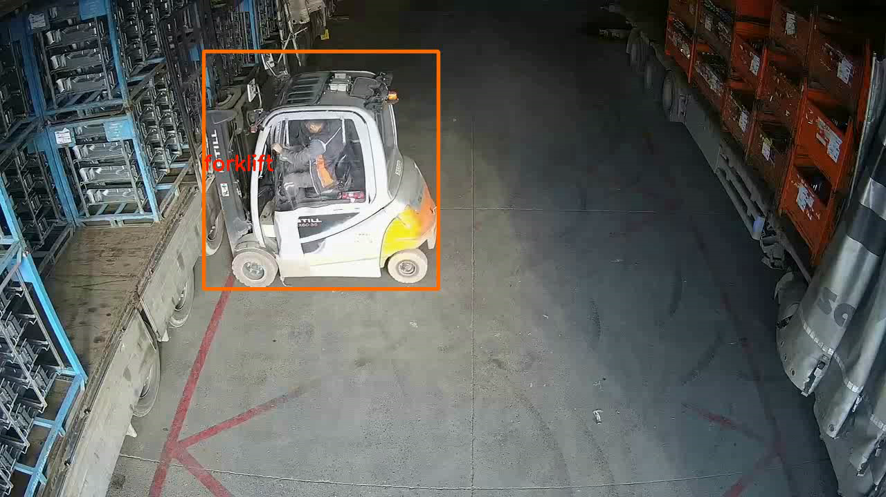
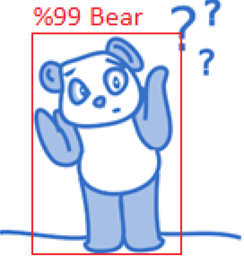
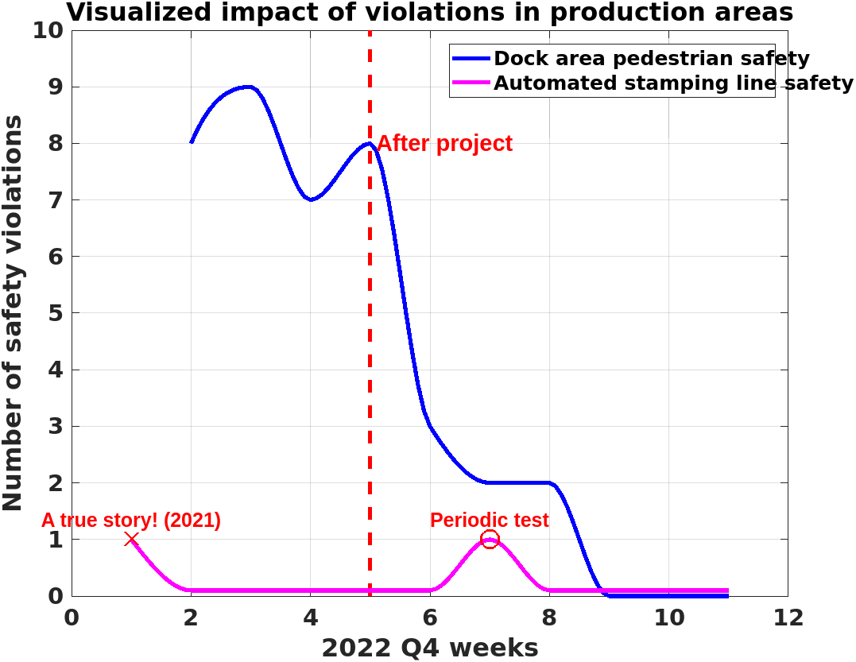
3. Safety Control Systems (Easy to Replicate. Modular.)
A loading dock area pedestrian safety violation example! (AI example)
Don't worry!
We detect potential accidents using Artificial Intelligence.
Human detected!
Emergency Stop
Human shouldn't be in that area while the forklift is moving!
Audio & Visual warning!
Visual system can detect different types of object, for example, human, forklifts etc.
Easily integrated with automatic production system e.g.
Low-cost, lightweight cameras.
Digitally analysis of safety events
More than 100 cameras will be deployed.
Send e-mail
Send message

Slide 7


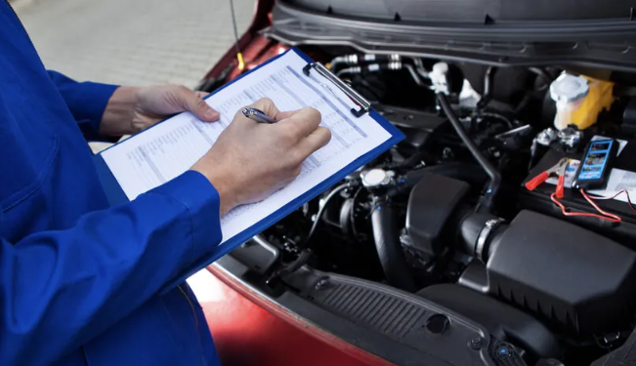
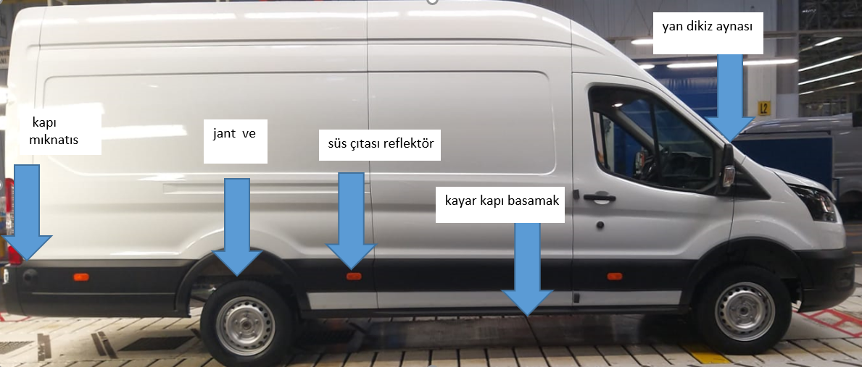
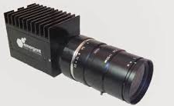
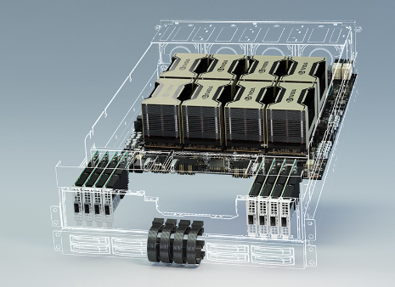
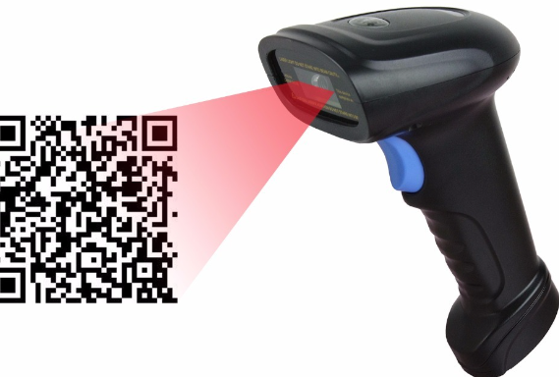
4. Quality Control Systems (High Accuracy AI Models)
Human eye based control
Quality System
Before Project
Side Mirror
Rear door magnet
Wheel
Model & Size
Detected cam
Undetected cam
Reflector
High resolution images
Door Step
After Project
Improve quality process
Store vehicle image data
Catch all possibility
Used high accuracy big size AI models in Data Center
AI software
Vehicle info barcode reader
Datacenter

Slide 8

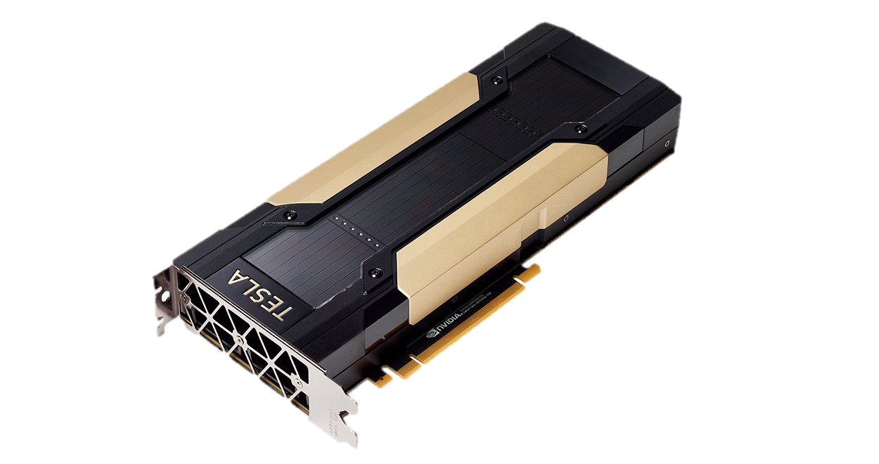
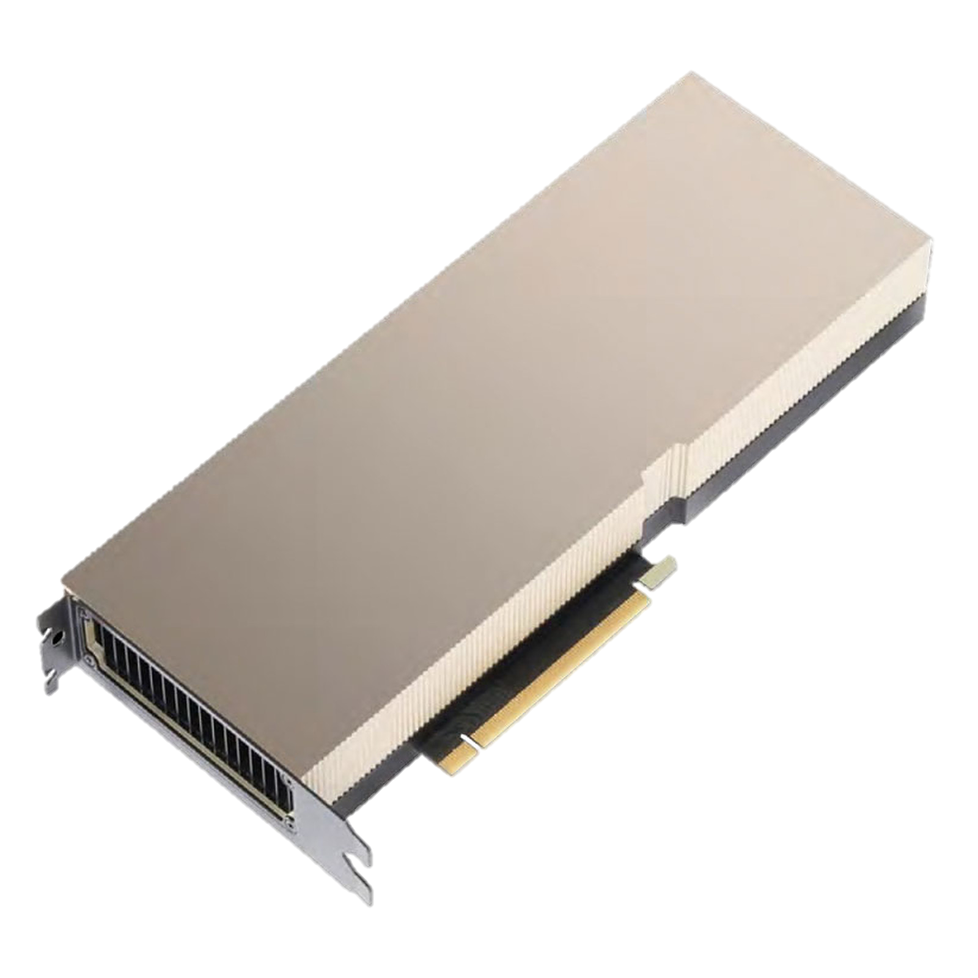
5. 1 MLOPS Solution: From Development to Production
Development
GPU Offloading
Hardware Aceeleration and Isolation
AI Model
FO Team
Virtual Desktop
Cloud IDE
GPU Powered Ubuntu Containers
GPU(vGPU)
GPU(vGPU)
GPU(vGPU)
AI Model Repository
GPU(vGPU)
Production
Quality Systems
GPU(vGPU)
Industrial Camera
Machine Vision Process
Triton Broker
Triton Inference Server
Triton Inference Server
Triton Inference Server
Industrial Camera
Machine Vision Process
AI Model 1
GPU(MIG)
AI Model 2
GPU(MIG)
Safety Systems
GPU(MIG)
IP Camera
IP Camera Process
GPU(MIG)
Triton Broker
GPU(MIG)
FO Team
IP Camera
IP Camera Process
AI Model n-1
GPU(MIG)
IP Camera
IP Camera Process
AI Model n
GPU(MIG)
IP Camera
IP Camera Process
GPU(MIG)
IP Camera
IP Camera Process
Robolaunch Core Services
Kubernetes Cluster
Bare Metal Servers

Slide 9









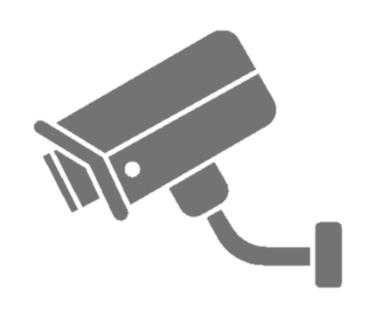
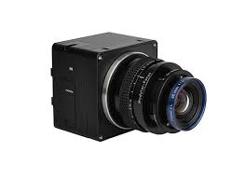
5.2 End to End AI Inference Pipeline
VPN
Kocaeli
Eskişehir
Romanya
Remote Location
Platform Team
Development Team
Users
Users
Users
Developer
Developer
Control Plane
Robolaunch Integration
Services
External
Services and Registries
Integration Cluster
Ubuntu 22.04
Data Plane
Robolaunch
Core and IDE&VDI
Robolaunch
Core Services and IDE
Robolaunch
Core Services and IDE
Robolaunch
Core Services and IDE
Triton Inference Server
Triton Inference Server
Triton Inference Server
Triton Inference Server
Development Cluster
Production Cluster
Production Cluster
Production Cluster
Ubuntu 22.04
Ubuntu 22.04
Ubuntu 22.04
Ubuntu 22.04
A100(vGPU)
A100(MIG)
A100(MIG)
A100(MIG)
V100(vGPU)
V100(vGPU)
V100(vGPU)
V100(vGPU)
H100(vGPU)
H100(MIG)
V100(vGPU)
H100(MIG)
H100(MIG)
x150
x100
x100

Slide 10
Additional Closing Comments
THANK YOU
FOR LISTENING

Slide 11

Frequently asked questions
Questions | Answers
How to calculate end to end response time ? (max. 400 milisecond) | Camera latency (150 ms) + consecutive 3 frame AI processing time ( 3 frame x 60 ms) + Server to PLC stop message latency (10 ms)
How to manage the Personal Data Protection Law process? | 1. We obtained monitoring consent from the employees that work in the relevant area. 2. We put clarification texts in relevant areas. 3. We have stored violation videos for three months in a private data center; only authorized persons can view them.
Do you have any device to show the system status in relevant areas? | We use tower lights that have three different colors to show system status. green: normal, no problem yellow: camera problem - unsafe area, stop line! red: emergency - human detected in line, stop!
What is Artificial Intelligence object/human detection accuracy? | We have a perfect object/human detection accuracy score using multiple cameras on corners in max. 400 milliseconds latency.
What are the necessary steps for a new installation? | IP CCTV cameras -> rtsp protocol support Automation panel -> Industrial computer, relays and switches, tower lights In-house Artificial Intelligence software -> host at GPU server The system is developed by Ford Otosan software developer teams with manufacturing teams, so it doesn't need software licenses or third-party companies.
What are your future plans? | Turkey, Kocaeli Plant -> The system has been working at two fully automated stamping lines and ten dock areas since Q4 2022. Turkey, Kocaeli Plant -> Three fully automated stamping lines and five dock areas – Planned Q3 2023 Romania, Craiova Plant -> Automated stamping lines and dock areas – Planned Q2 2024
How to ignore out-of-scope areas seen by cameras? | We mask the areas using black pixel windowing, so the system doesn't respond in out-of-scope areas.

